Slide 1

Maeon laboratory
Essential Test Needed For Best Quality Assurance Of Packaging Materials
https://www.maeonlabs.in/films-testing.php

Slide 2
Bundling materials are popular in an assortment of ventures. Bundling of an item altogether affects the quality and appearance. The bundling handles the best quality confirmation, security, and newness of the item that is bundled in the bundling.
For best assurance of the item during transportation and capacity, it is fundamental to guarantee that the best nature of bundling materials is utilized for bundling of items.
The makers need to test the materials and items delivered by them for better quality. There is a wide range of testing systems that should be run on the bundling materials for best quality affirmation.
Here is a portion of the quality confirmation tests that are generally utilized in bundling businesses.

Slide 3
Co-efficient of friction test
The coefficient of a grating is the property of a material that makes it go against any movement in it. Careful assurance of the opposition presented by a bundling material is exceptionally important to choose variables of wellbeing during stockpiling and transportation. The coefficient of the grating analyzer is an ideal instrument that gives a definite estimation of the contact presented by a bundling item.
Box Compression Test
The pressure strength of the bundling box is a fundamental quality that should be tried to choose the reasonableness of a material for specific working conditions. The crate pressure analyzer is an ideal testing instrument that aides in deciding the case pressure strength under explicit burdens.

Slide 4
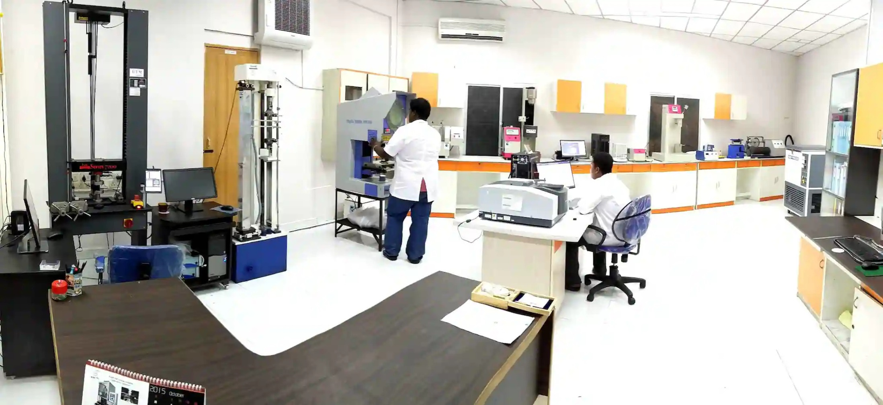

Slide 5
Dart Impact Test
The dart sway test is utilized for assurance of the effect opposition of a uninhibitedly falling dart. The test methodology is done by applying shifting impact on the plastic movies from a uninhibitedly falling dart from various statures.
It is utilized for deciding the base measure of power that is needed for the disappointment of the film testing laboratory in chennai under various stacking conditions. For this test methodology, a dart sway analyzer is utilized for high accuracy and exactness.
Opacity Test
The murkiness analyzer is utilized for testing the mistiness of a bundling material like names, and so on With the appropriate murkiness of bundling materials, the covering of the materials like inks, and so forth turns out to be extremely less.
The mistiness analyzer is a computerized instrument that is utilized for precise contemplating of the haziness of the bundling materials. Aside from these tests, there are additionally numerous different tests that are should have been directed to guarantee the best nature of bundling materials.
These tests incorporate blasting strength, cut opposition test, scrape test, drop test, cob measuring test, etc.

Slide 6
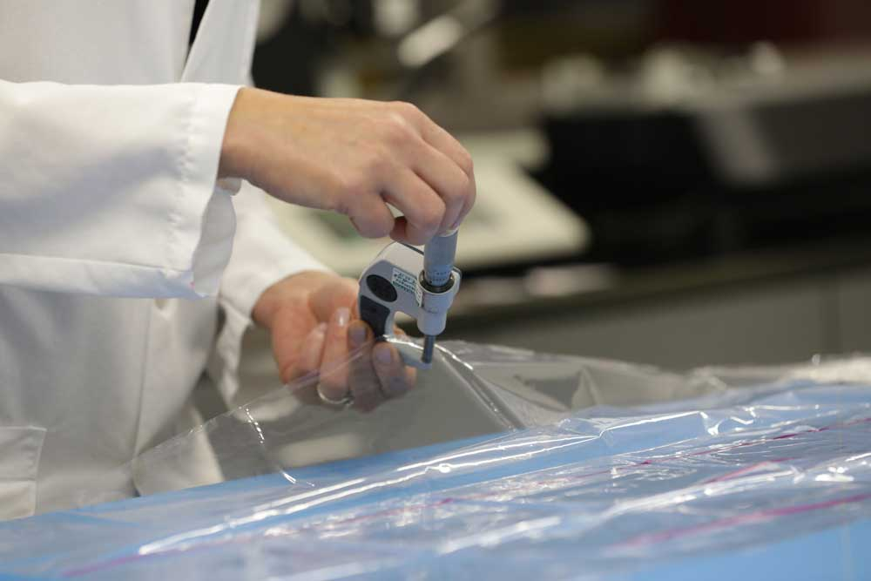
Film testing

Slide 7
Contact Us
Chennai
Coimbatore
E-mail id
testing@maeonlabs.com
maeonlabs@gmail.com
Phone
+91 44-65555689
+91 99406 67389
E-mail id
maeoncbe@gmail.com
Phone
+91 422-3511389
+91 75501 44770

Slide 8
Location
Chennai
Coimbatore
14, Lakshmikanthammal 1st Street,
Rajiv Nagar, Vanagaram,
Chennai.
Pincode - 600 077
SVP Complex I floor D,
343, Avarampalayam Road, (VKK Manon Rd Jn),
Coimbatore.
Pincode 641044

